Slide 1

DESIGN
‘PATTERN’
IN JAVA
[GoF Design Patterns]

Slide 2
[Creational Patterns]

Slide 3
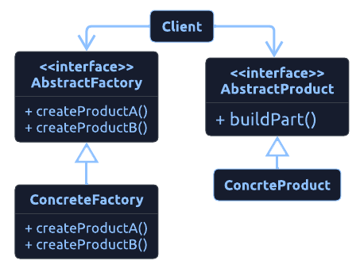
[ What is ‘Abstract Factory’? ]
[ Object Creational ]
Why?
<Provide an interface that delegated creation calls to one or more concrete classes to deliver specified objects./>
When?
<It used :
Objects should be created independently of the system that will utilize them.
Systems should be able to use distinct object families.
Object families must be used in conjunction.
Libraries must be published without exposing implementation details.
Concrete classes should be decoupled from clients./>
Example
< Email editors will support editing in a variety of forms, including plain text, rich text, and HTML. Various objects must be generated depending on the format. If the message is plain text, there might be a body object that only represented plain text and an attachment object that simply encrypted the attachment into Base64. If the message is HTML, the body object represents HTML encoded content, and the attachment object supports both inline representation and normal attachments. We can then ensure that the correct object sets are formed based on the style of email that is being sent by using an abstract factory for creation./>

Slide 4
‘Abstract Factory’
[Implementation & Testing]
<We are going to:
Create interfaces Animal & Color
Create a concrete implementation of Duck, Dog for Animal interface & Brown, White for Color.
Implement an AbstractFactory for them.
Implement a concrete version AnimalFactory & ColorFactory using the design pattern.
Make a FactoryProvider class that will provide us with an implementation of AnimalFactory or ColorFactory depending on the argument supplied to the getFactory() method./>

Slide 5
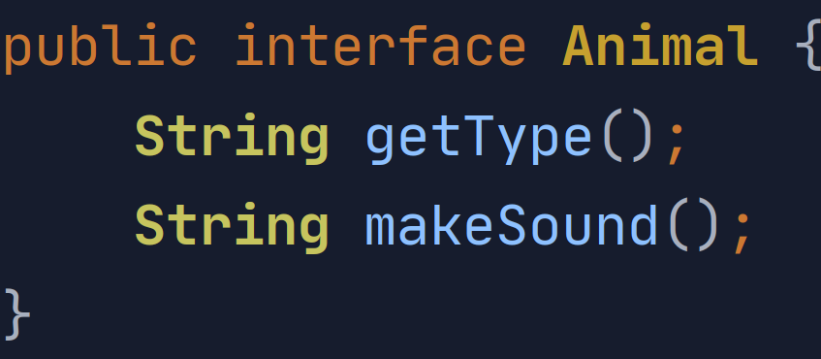
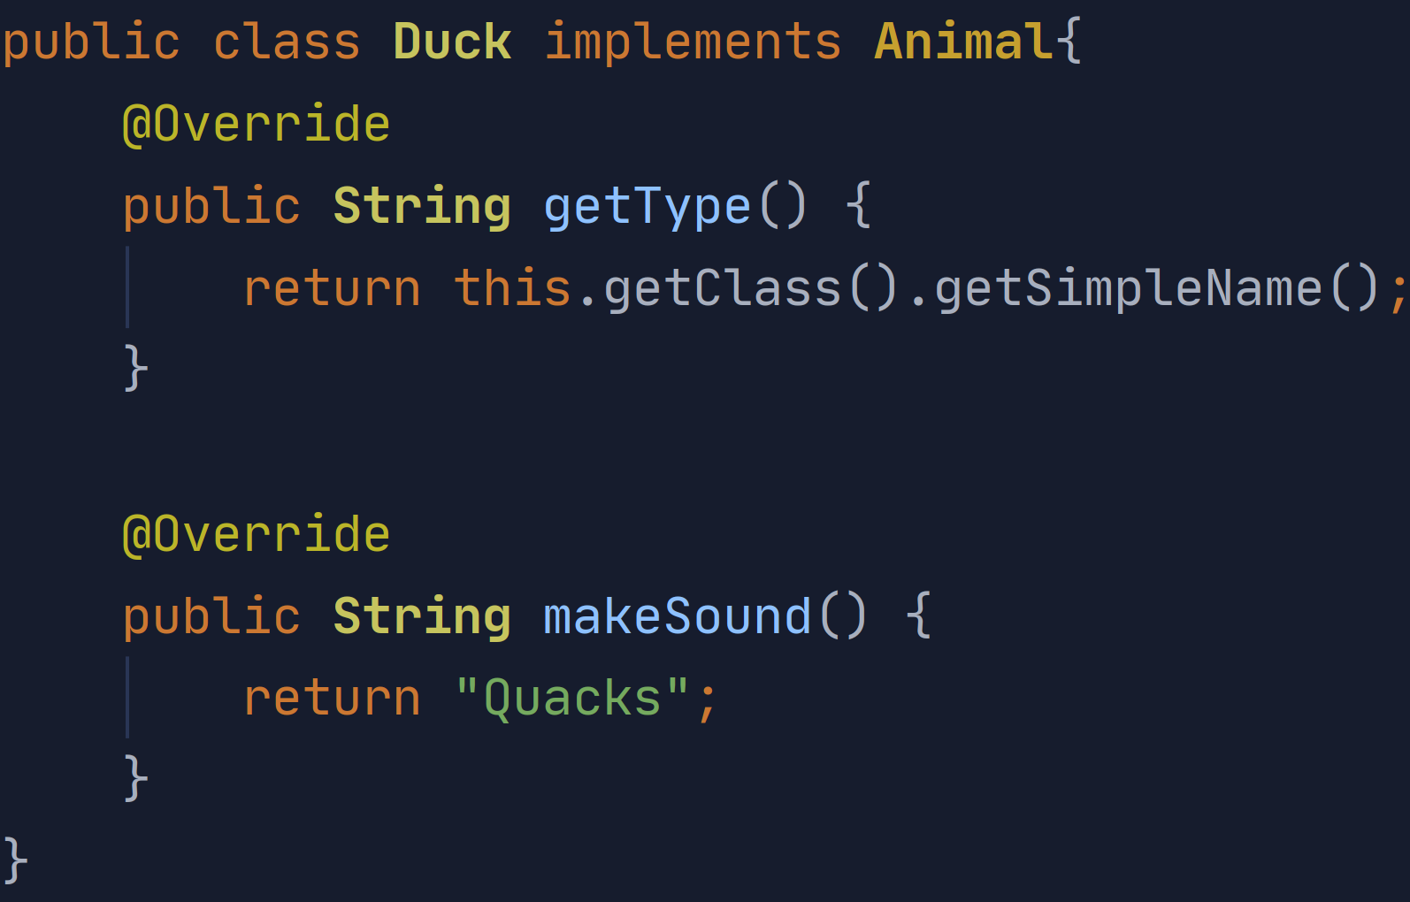
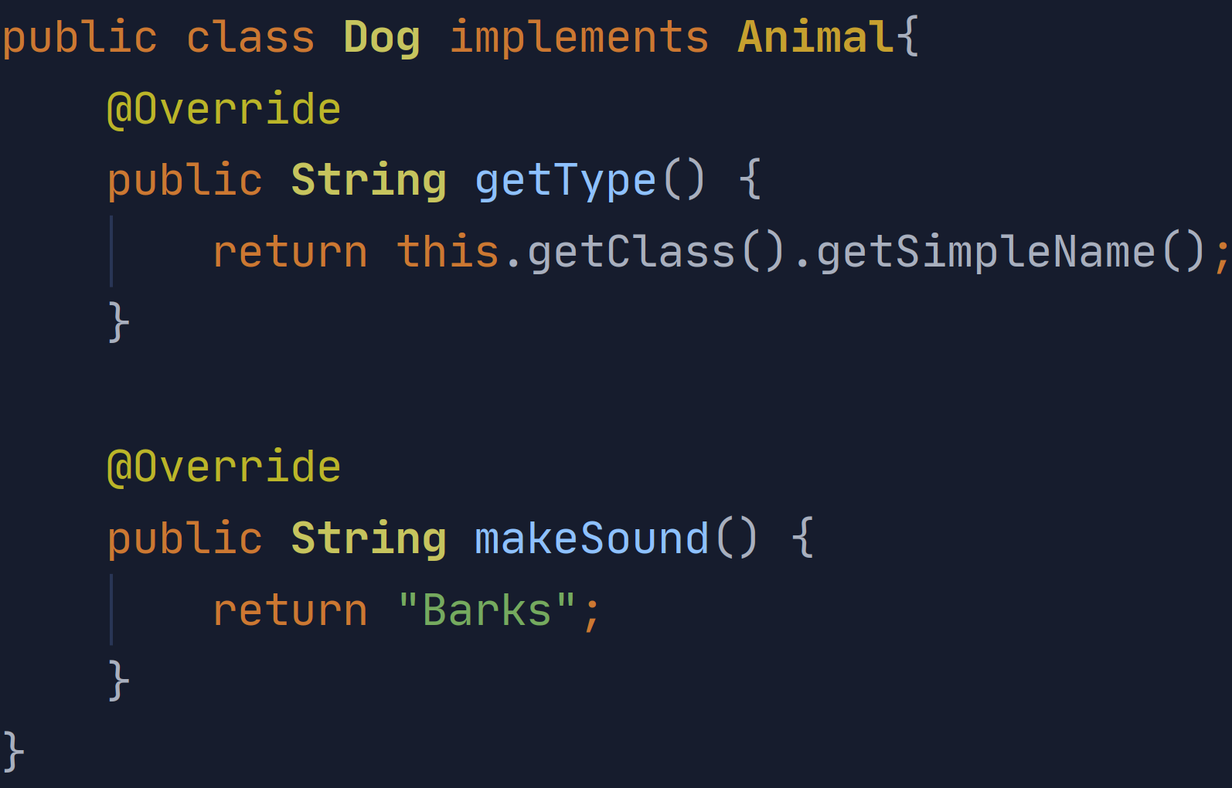
‘Abstract Factory’
[Implementation & Testing]

Slide 6
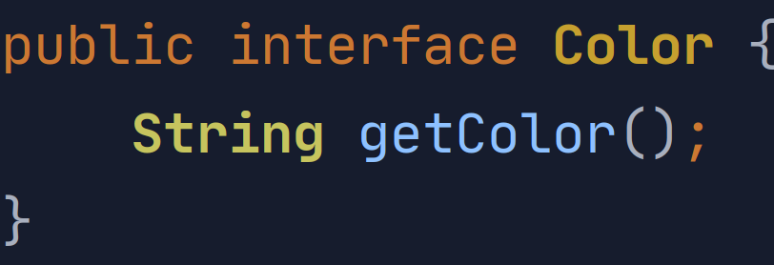
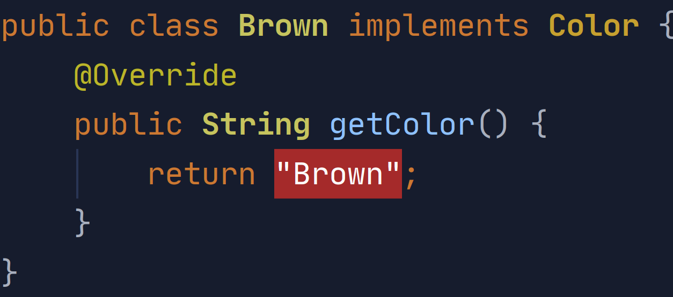
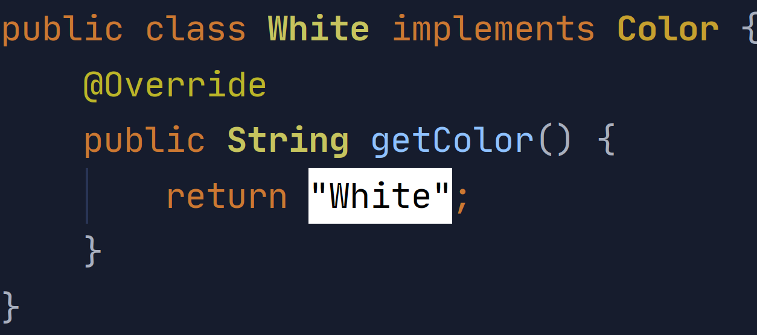
‘Abstract Factory’
[Implementation & Testing]

Slide 7
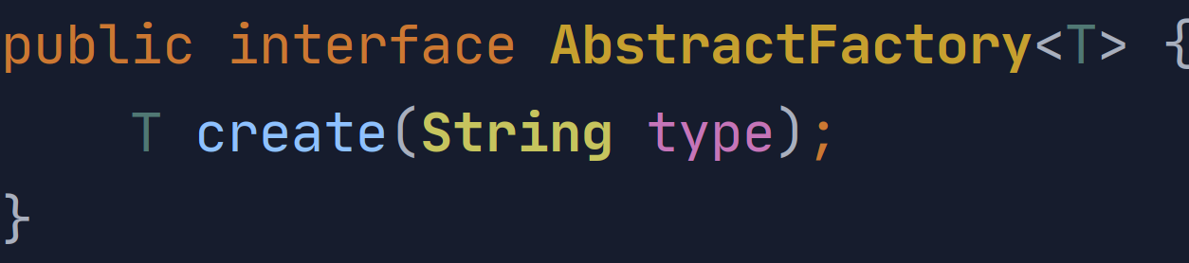
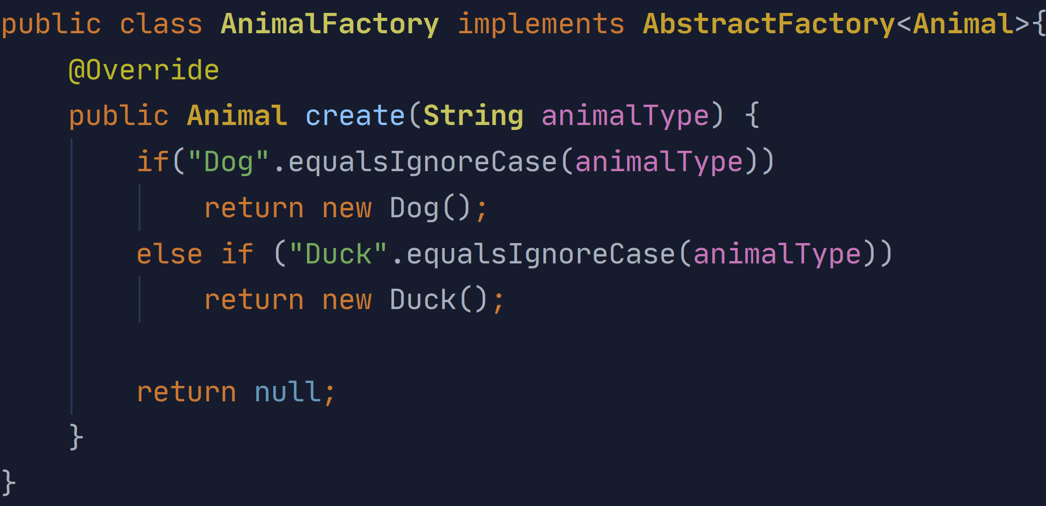
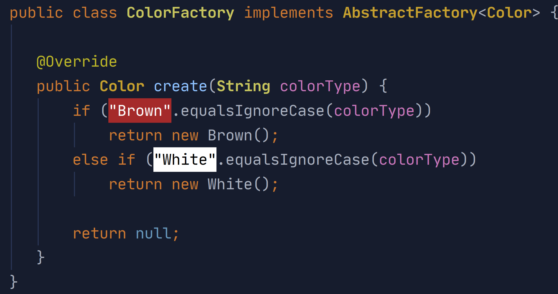
‘Abstract Factory’
[Implementation & Testing]

Slide 8
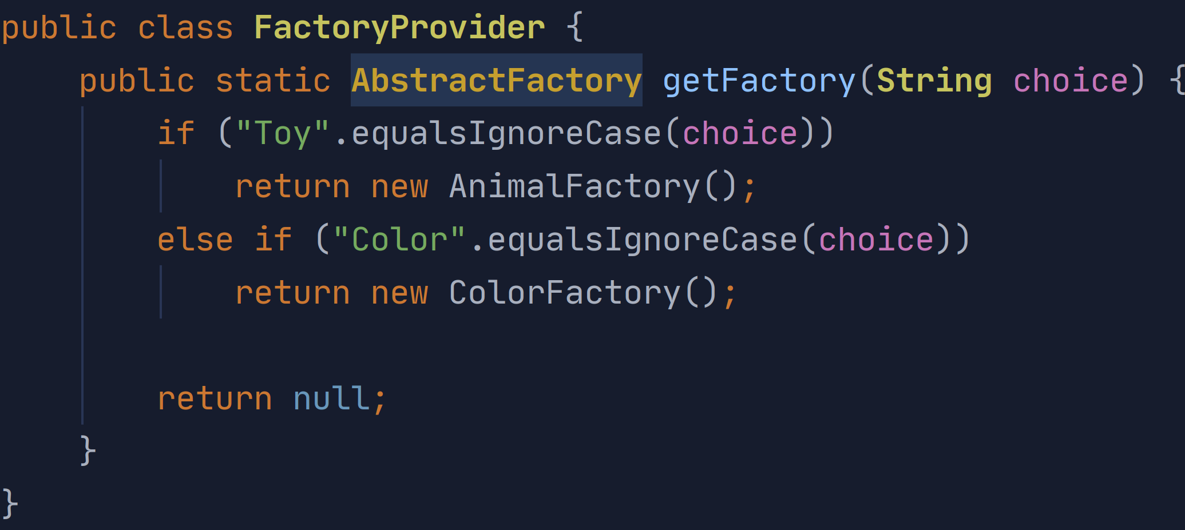
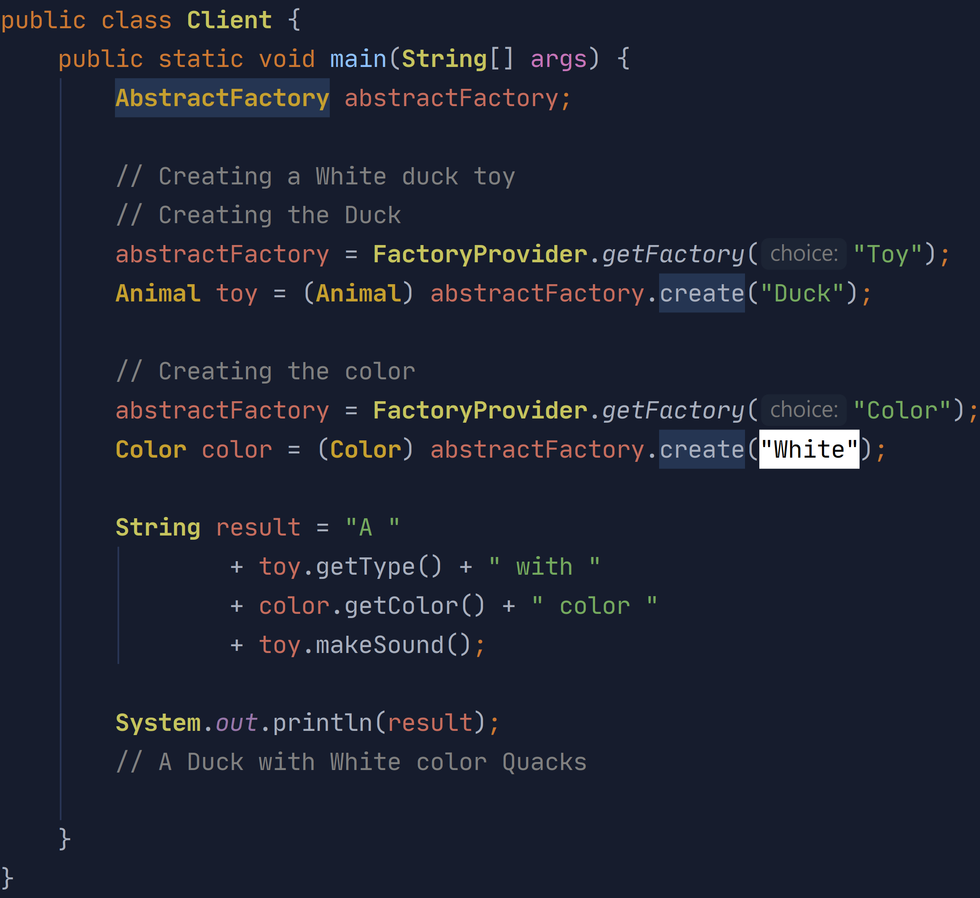
‘Abstract Factory’
[Implementation & Testing]

